Slide 1
B.ED. SECOND YEAR - Important - viva Questions for practical Examination
Dr.Subha

Slide 2
NUMBER OF RECORDS SUBMITTED
FOR EACH PEDAGOGY
1.LESSON PLAN RECORDS - 2
2.LESSON OBSERVATION RECORD - 1
3.DIAGNOSTIC AND REMEDIATION RECORD - 1
4. EPC 4 – ENHANCING PROFESSIONAL CAPACITY - INTERNAL
5. YOGA AND HEALTH EDUCATION RECORD - INTERNAL

Slide 3
MICRO TEACHING

Slide 5
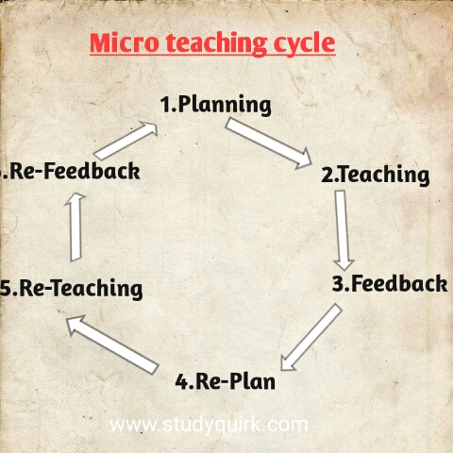

Slide 6
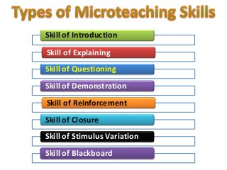

Slide 7
TEST MEASUREMENT AND EVALUATION

Slide 9
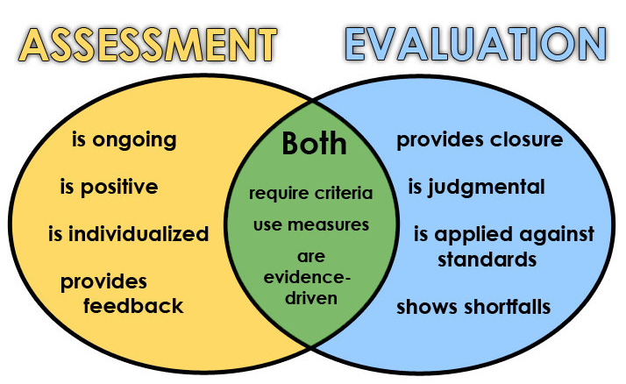

Slide 10
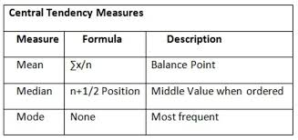
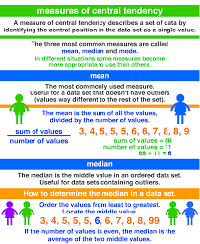

Slide 11
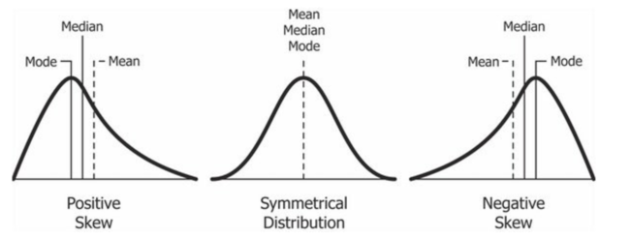

Slide 12
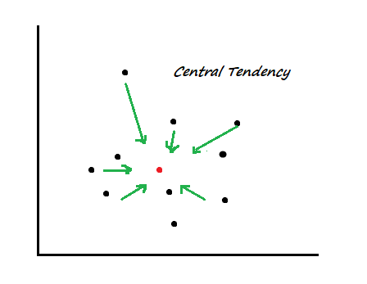
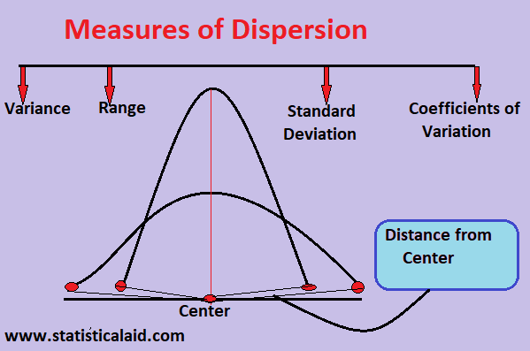

Slide 13
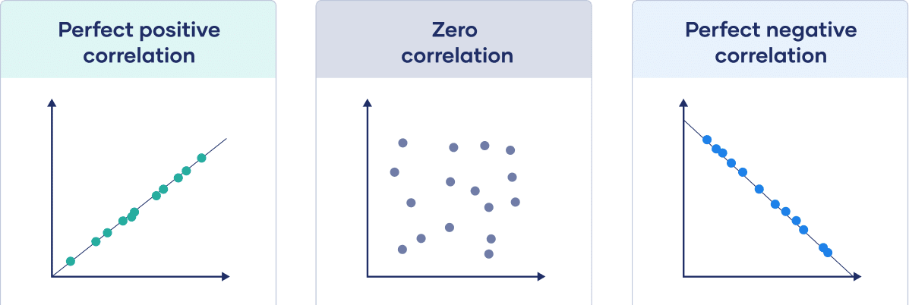

Slide 14
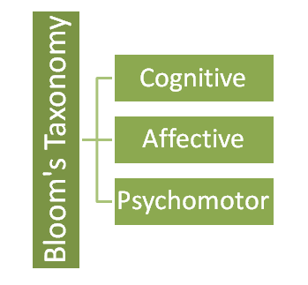
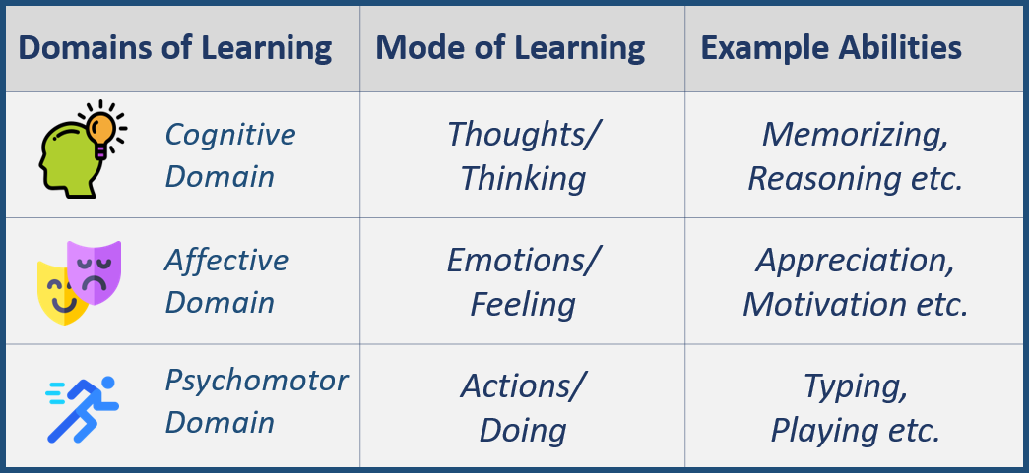

Slide 15
COGNITIVE DOMAIN

Slide 16
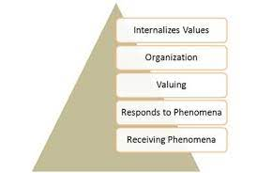
AFFECTIVE DOMAIN

Slide 18
Diagnosis and Remedial teaching

Slide 19
THANK YOU

